Slide 1

COMPUTER NETWORKS
Sivaraman Eswaran Ph.D.
Department of Computer Science and Engineering

Slide 2

COMPUTER NETWORKS
Computer Networks and the Internet
Sivaraman Eswaran Ph.D.
Department of Computer Science and Engineering

Slide 3








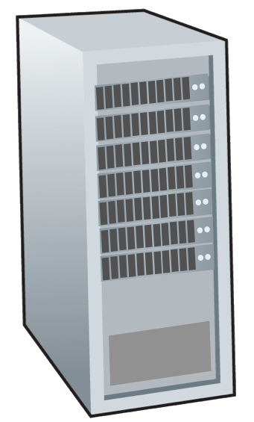







COMPUTER NETWORKS
The Internet: A “Service” View
Infrastructure that provides services to applications:
Web, streaming video, multimedia teleconferencing, email, games, e-commerce, social media, inter-connected appliances, …
mobile network
national or global ISP
Streaming
video
Skype
local or regional ISP
provides programming interface to distributed applications:
“hooks” allowing sending/receiving apps to “connect” to, use Internet transport service
provides service options, analogous to postal service
home network
content
provider
network
HTTP
datacenter
network
enterprise
network

Slide 4
COMPUTER NETWORKS
What is a Protocol?
Human protocols:
“what’s the time?”
“I have a question”
introductions
… specific messages sent
… specific actions taken when message received, or other events
Network protocols:
computers (devices) rather than humans
all communication activity in Internet governed by protocols
Protocols define the format, order of messages sent and received among network entities, and actions taken on msg transmission, receipt.

Slide 5

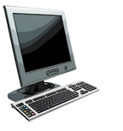

COMPUTER NETWORKS
What’s a Protocol?
A human protocol and a computer network protocol:
Hi
TCP connection
request
Hi
TCP connection
response
Got the
time?
GET http://gaia.cs.umass.edu/kurose_ross
2:00
<file>
time
Q: other human protocols?

Slide 6


COMPUTER NETWORKS
Queries

Slide 7
THANK YOU
Sivaraman Eswaran Ph.D.
Department of Computer Science and Engineering
sivaramane@pes.edu
+91 80 6666 3333 Extn 834

